Slide 1
COMP 453:Database Programming
Project: Cozy Homes
Members: Pallavi Agarwal, Madhura Joshi, Smruti Tatavarthy (TEAM 5)

Slide 2
Summary
This application is being developed for the real estate business. This application allows the organization to search properties on a rental basis and not for sale/purchase.
The mission of this application is to help real estate agencies find homes according to the price, type of apartment and location that the end user requires. End users can also use this application for searching properties. But only the administrators will be able to edit details of database like add properties, delete properties, change price of the property.

Slide 3
Purpose
Purpose of this application is to build a database of different types of properties like apartment (1bed, 2bed, and 3bed), condos, cottages, duplex, townhouses etc. The database will have the prices for these properties, ratings for these properties (1, 2, 3, 4, 5) the lease period and location in that particular city. The database will also have agents associated with those properties in a particular location. The agents will have ratings (poor, good, excellent).

Slide 4


Slide 5
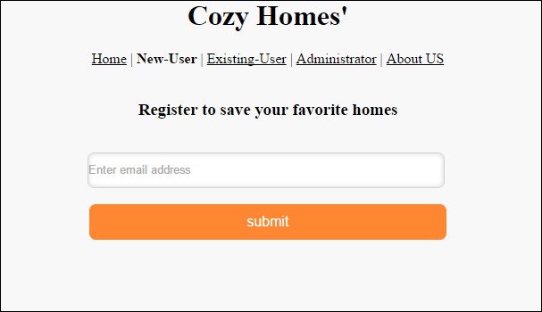
New user registration

Slide 6
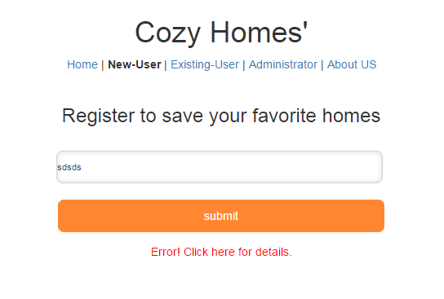
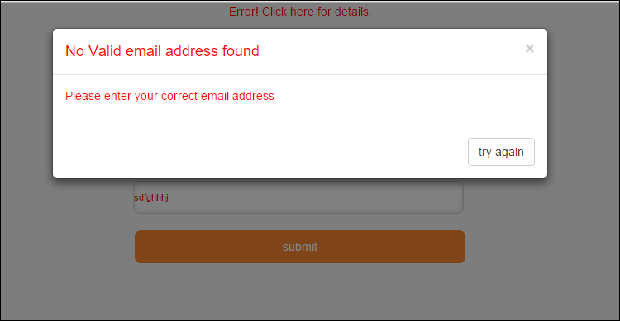
Validations for user entered input.
Check for empty fields and presence of a valid email that include ‘@’ and ‘.’ characters.
Display the appropriate message on invalid input entered by user.

Slide 7
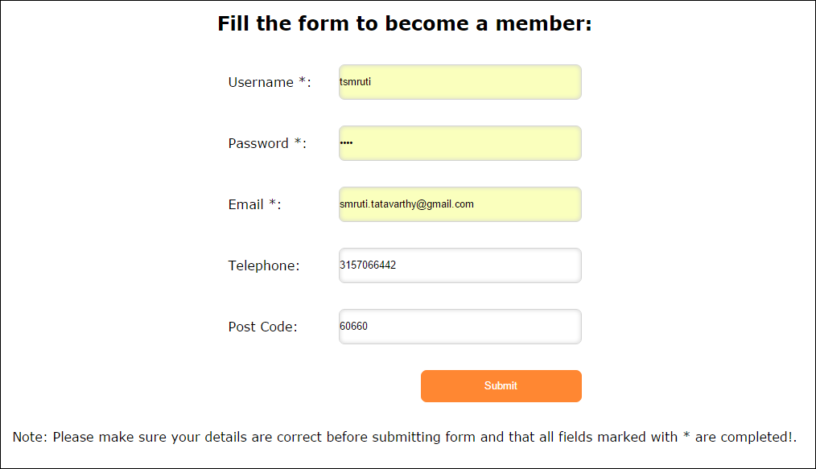
Form for new user registration

Slide 8
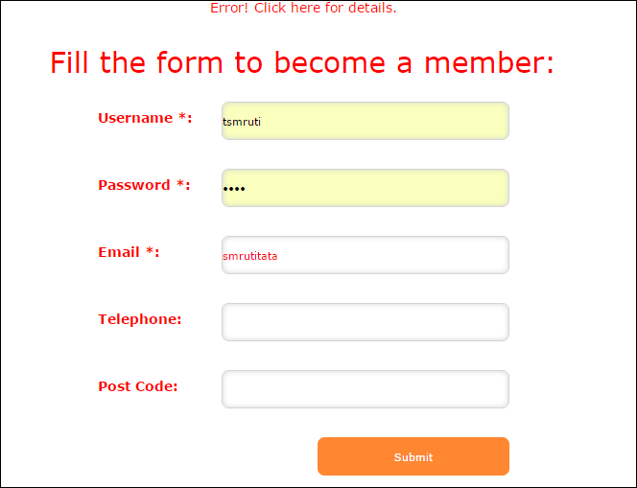
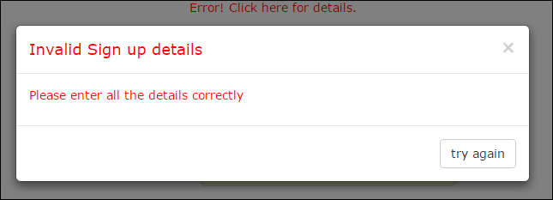
Validations for user entered input.
Check for empty input and presence of a valid email that include ‘@’ and ‘.’ characters.
Display the appropriate message on invalid input entered by user.

Slide 9
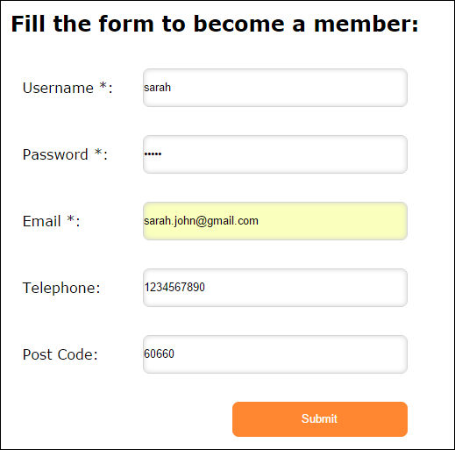

As soon as the new user enters his password, the password is hashed in to database for security purposes.

Slide 10
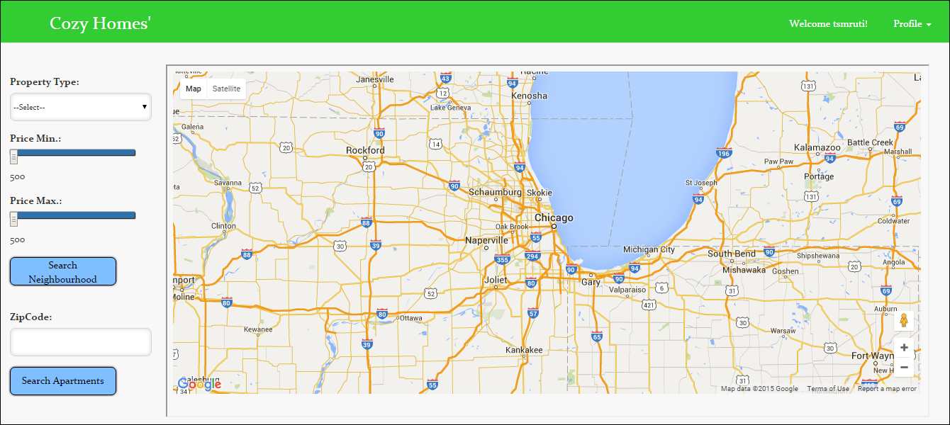
After Successful Login or Signup user is directed to listing page

Slide 11
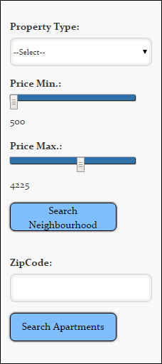
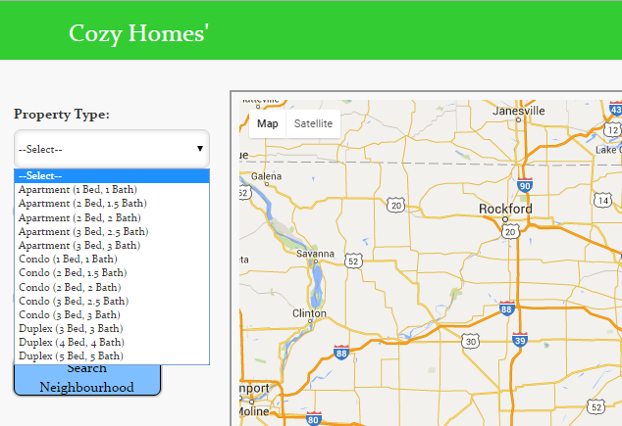
Search criteria- Property Type, Price, Zip Code
Property Type is fixed in the database and can be only from the drop down choices.
Price Sliders make it easy for users to give their desired range of price.

Slide 12
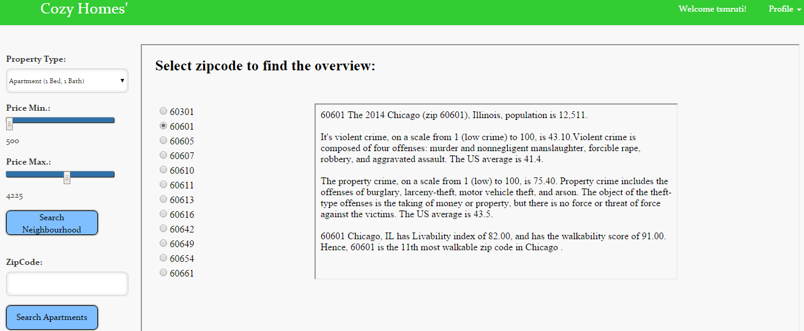
After specifying search criteria, user is given a list of zip codes as per the search criteria with information about the surroundings.
After user has made a decision of which zip code is safe, he
can enter the zip code to search for apartments in that area.

Slide 13
Underlying SQL Correlated SubQuery
SELECT DISTINCT(ZipCode) as zipcode
from property
WHERE EXISTS
(SELECT * FROM apartment, propertytype WHERE property.PropertyID = apartment.PropertyID AND propertytype.TypeID = apartment.TypeID AND
propertytype.TypeName='$type' AND
apartment.Price BETWEEN '$priceMin‘ AND'$priceMax')
ORDER BY ZipCode";

Slide 14
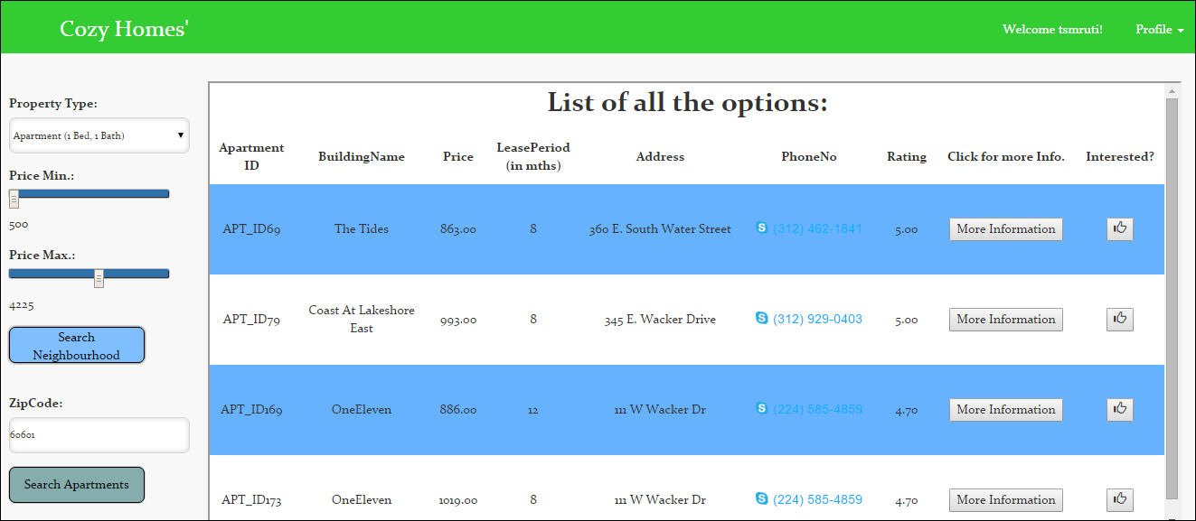
List of Apartments as per user’s search criteria
User can click on more information
User can hit like, and it will be stored in his interests

Slide 15
Underlying SQL-JOIN
SELECT property.PropertyID, Apartment.ApartmentID, property.PropertyName, propertytype.TypeName, apartment.Price, apartment.LeasePeriod, property.Address property.ZipCode, property.PhoneNo, property.Rating
FROM Property, Apartment, propertytype
WHERE propertytype.TypeID= apartment.TypeID AND
apartment.PropertyID = property.PropertyID AND
propertytype.TypeName = :TypeName AND
property.ZipCode = :ZipCode AND
Price BETWEEN :minPrice AND :maxPrice';

Slide 16
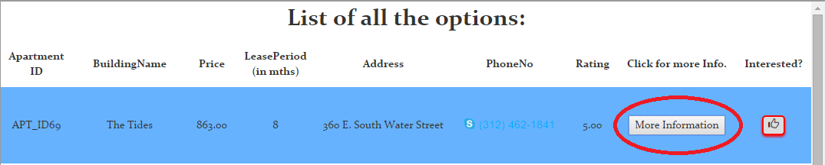
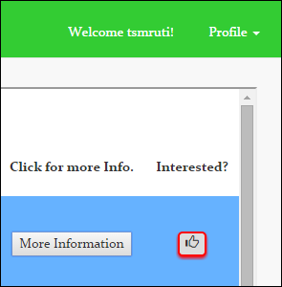
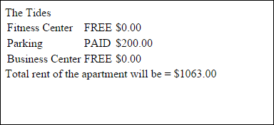
Like button turns red when clicked, and the apartment details are saved in users interests.

Slide 17
Underlying SQL- Insert during execution of application
INSERT INTO userinterest SET
username = :username,
ApartmentID = :ApartmentID,
PropertyName = :PropertyName,
TypeName = :TypeName,
Price = :Price,
LeasePeriod = :LeasePeriod,
Address = :Address,
ZipCode = :ZipCode,
PhoneNo = :PhoneNo

Slide 18
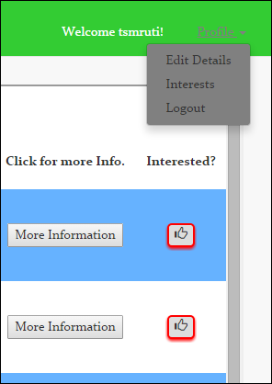
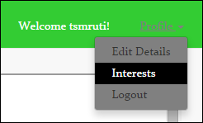
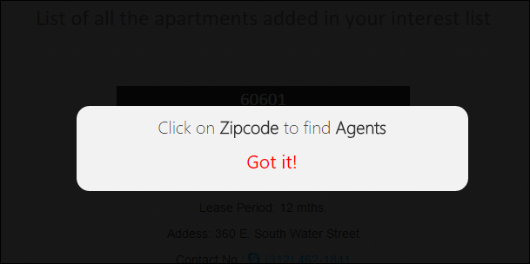
Every user has a profile settings option, where he can edit his details, and check the apartments he liked.
Clicking the interest button, user can check apartments and agents in that area.

Slide 19
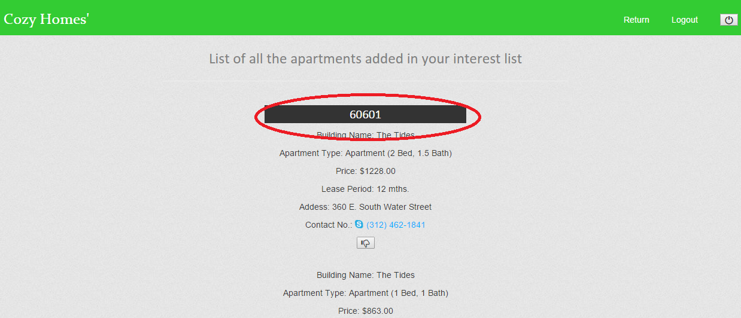
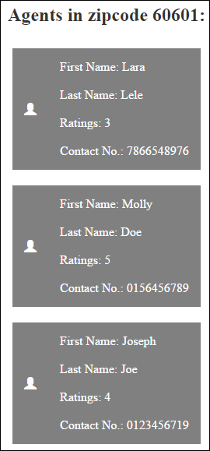
List of apartments that the user liked.
Clicking the zip code user can get the list of agents in the zip code

Slide 20
Underlying SQL-SubQuery
SELECT *
from userinterest
where UserName = :username and userinterest.ApartmentID
IN (SELECT Apartment.ApartmentID
FROM Property, Apartment, propertytype
WHERE propertytype.TypeID= apartment.TypeID AND
apartment.PropertyID = property.PropertyID AND
propertytype.TypeName = :TypeName AND
property.ZipCode = :ZipCode AND
Price BETWEEN :minPrice AND :maxPrice)

Slide 21
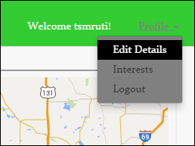
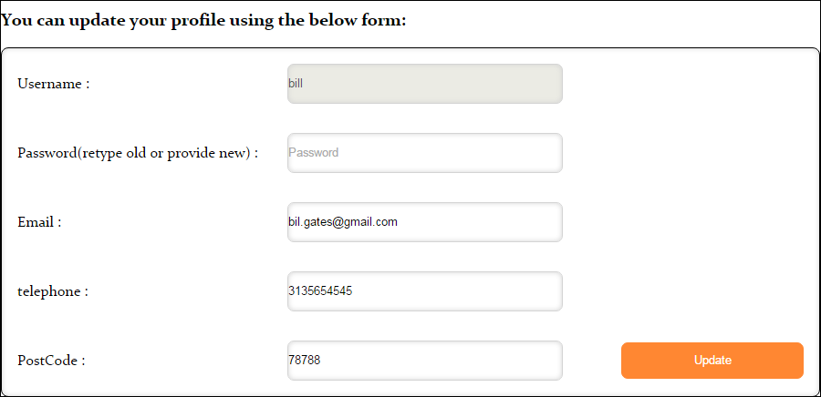
User can edit his personal details

Slide 22
ADMIN PAGE
Administrator has additional privileges apart from those already present for users.
Administrators can add, modify and delete new properties, apartments.
There is a separate login for administrators where only those users have admin rights can login

Slide 23
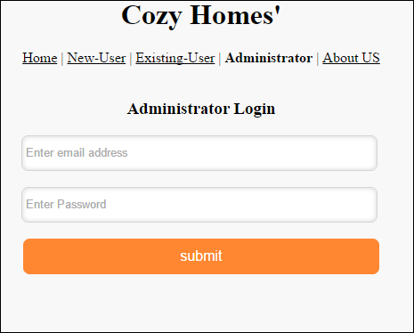
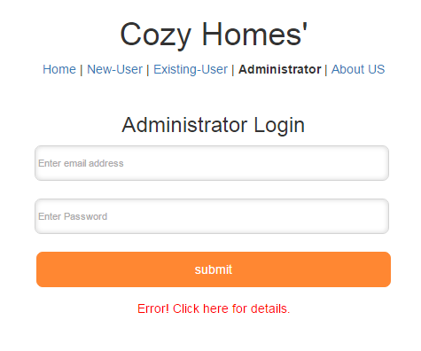
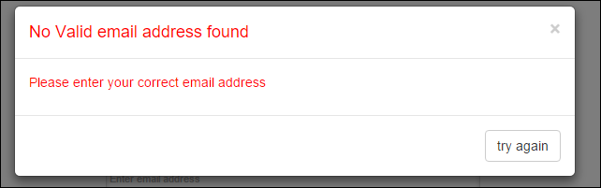
Validations for admin entered input.
Display the appropriate error message

Slide 24
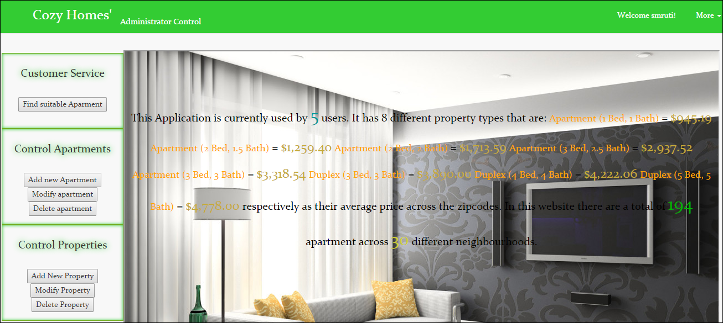
After Successful Login admin is directed to listing page for Admins

Slide 25
Underlying SQL-Aggregate
SELECT propertytype.TypeName as TypeName, AVG(Price) as Average
FROM propertytype, apartment
WHERE apartment.TypeID=propertytype.TypeID
GROUP By apartment.TypeID";

Slide 26
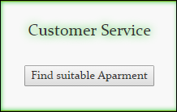
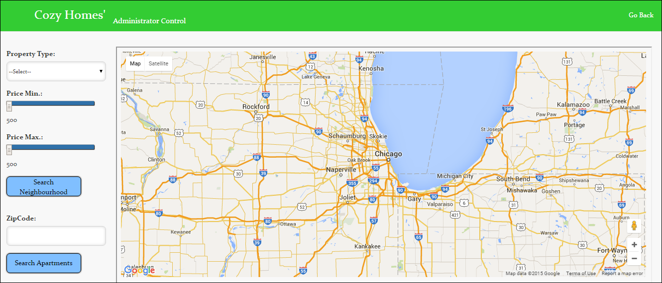
Admins can also search for apartments, after
which they are directed to listing page just like
Users.

Slide 27
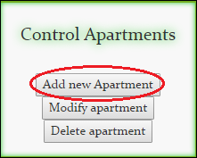
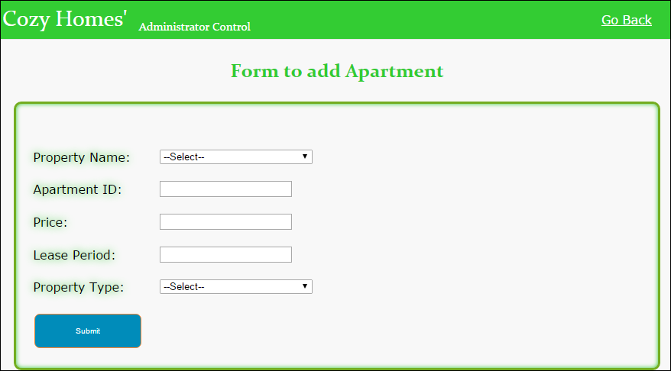
Admins can add new apartment in
existing property.

Slide 28
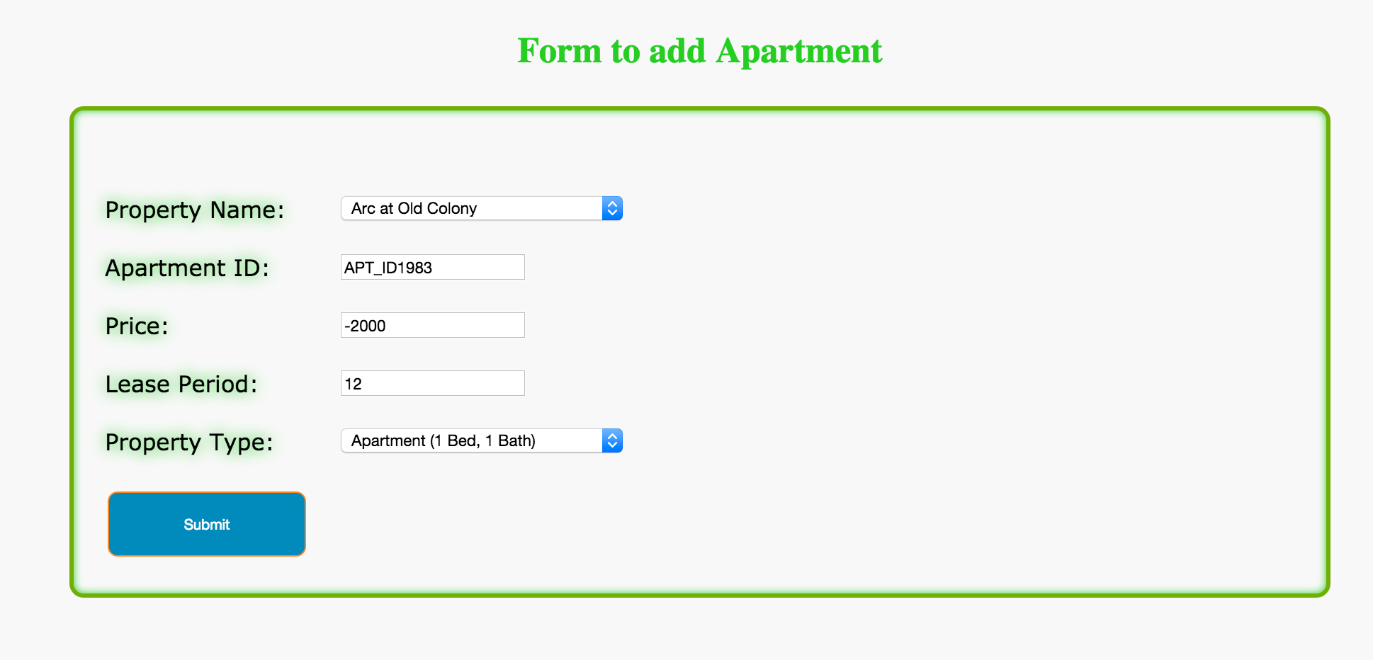
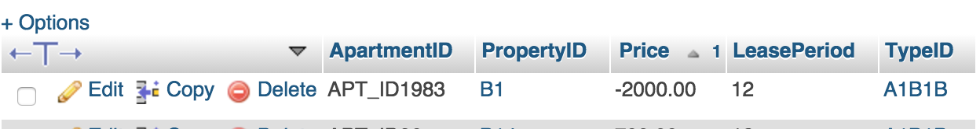
Without the ‘Rollback’ statement, record will be added to the database.

Slide 29
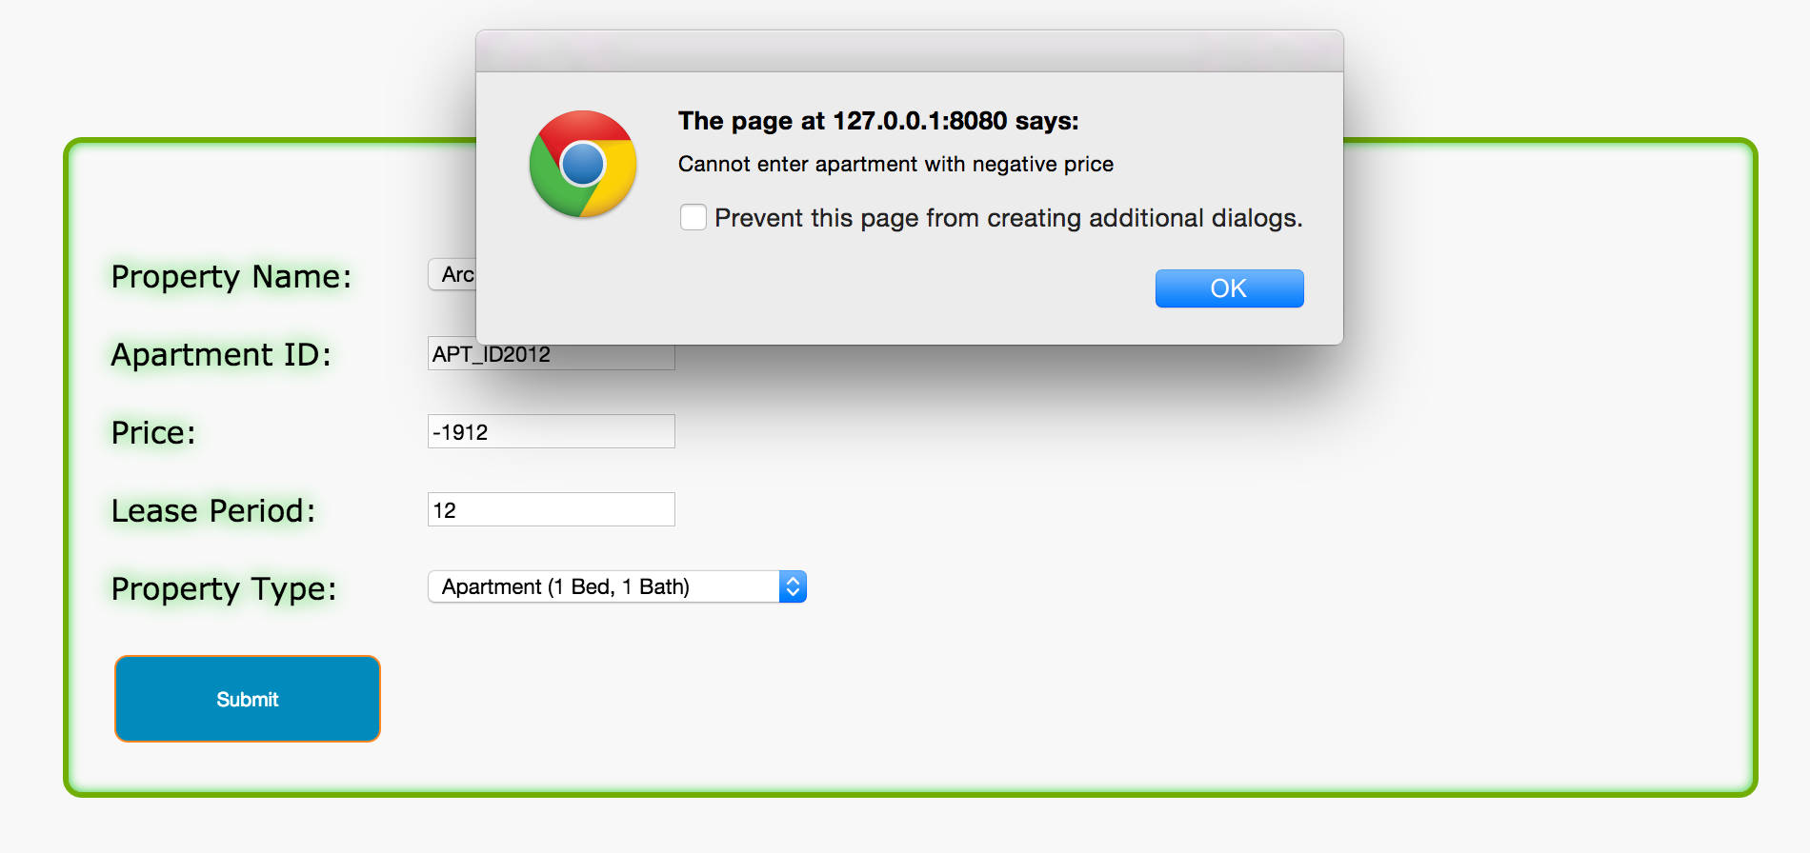
Once the Rollback’ statement, is set the record will be rolled back from the database and pop-up will be shown.

Slide 30
Underlying SQL-Transaction Commit and Rollback
$pdo = connectToDB();
$pdo->beginTransaction(); // it will turn off the auto commit
INSERT INTO apartment VALUES('$apartmentID','$propID',$price,'$lease','$type')“
$pdo->exec($sql); // now data has already entered thedatabase
if($price<0){
//data will be rollbacked because price is negative
$pdo->rollback();
$message = "Cannot enter apartment with negative price";
echo "<script type='text/javascript'>
alert('$message');</script>";
}else
{//else data will not be rollbacked.and committed.
$pdo->commit();
}

Slide 31
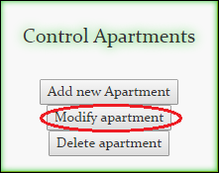
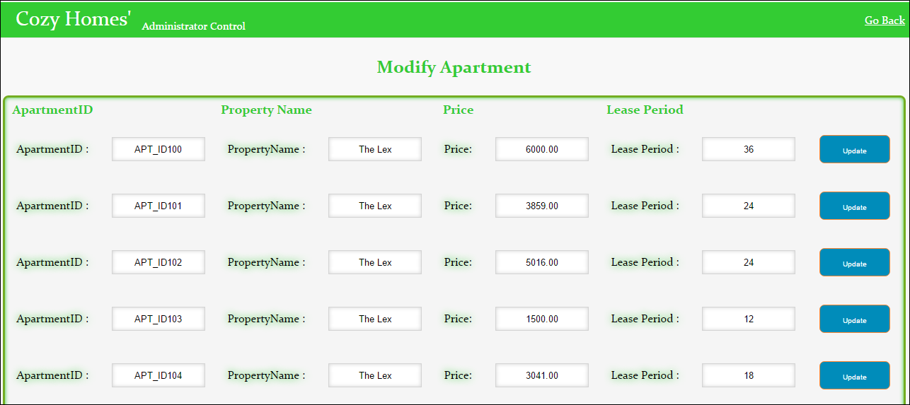
Admins can modify price and lease Period
of existing apartments in existing property.

Slide 32
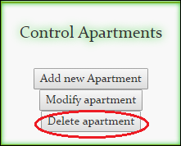
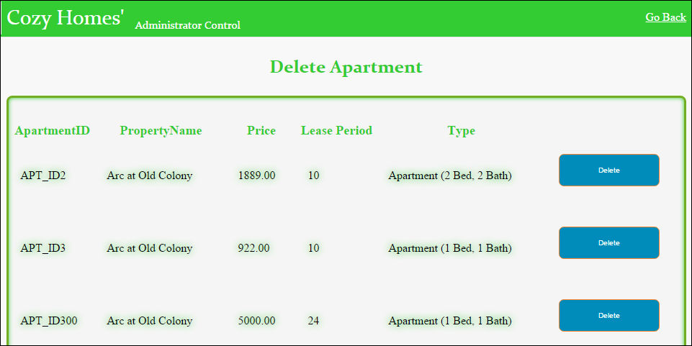
Admins can delete existing apartments in
existing property.

Slide 33
Underlying SQL-DELETE
DELETE FROM apartment WHERE ApartmentID = '$aptID'

Slide 34
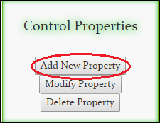
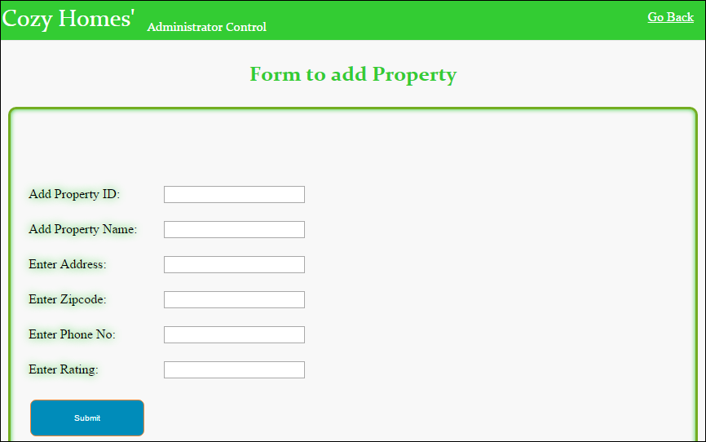
Admins can add a new property in the database

Slide 35
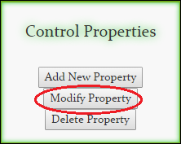
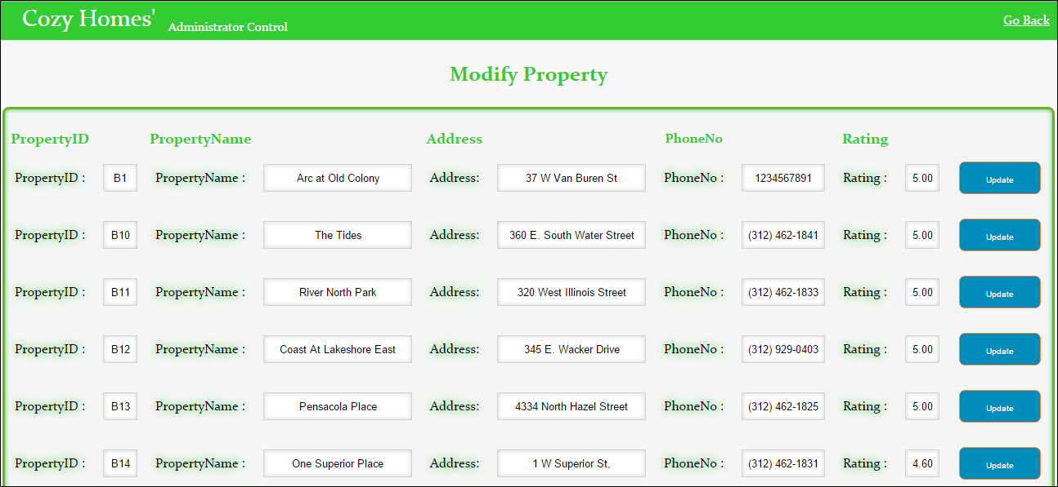
Admins can modify details (address, phone no
and ratings of existing properties in the database

Slide 36
Underlying SQL- Update & Join
UPDATE apartment SET Price='$price',LeasePeriod='$lease' WHERE ApartmentID='$apartmentid'
SELECT apartment.ApartmentID, property.PropertyName, apartment.LeasePeriod, apartment.Price
FROM apartment, property
where apartment.PropertyID=property.PropertyID

Slide 37
Referential Integrity
Property ID which is PK in ‘Property’ is a FK in ‘Apartment’ and ‘PropertyUtility’ tables. Hence when an administrator deletes a property record. The corresponding record should be deleted from both ‘Apartment’ and ‘PropertyUtility’ tables.
We have implemented this by using On Delete Cascade.
For Property Utility: Alter table propertyutility drop FOREIGN KEY propertyutility_FK1; alter table propertyutility add CONSTRAINT propertyutility_FK1 FOREIGN KEY(PropertyID) REFERENCES Property(PropertyID) on DELETE CASCADE;
For Apartment: Alter table apartment drop FOREIGN KEY Apartment_FK2; alter table apartment add CONSTRAINT Apartment_FK2 FOREIGN KEY(PropertyID) REFERENCES Property(PropertyID) on DELETE CASCADE;

Slide 38
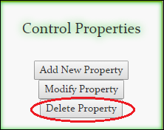
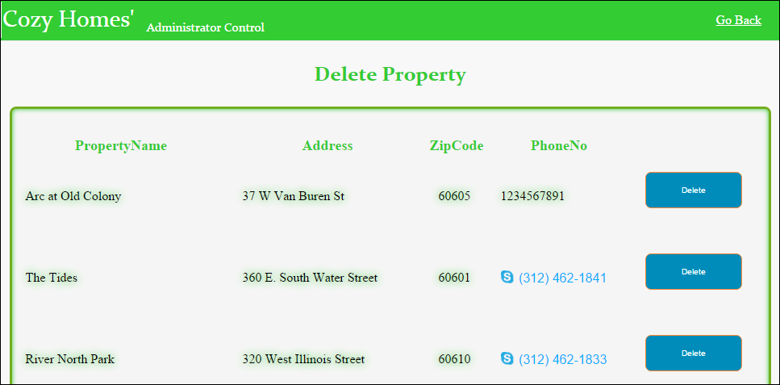
Admins can delete properties from the existing
database

Slide 39
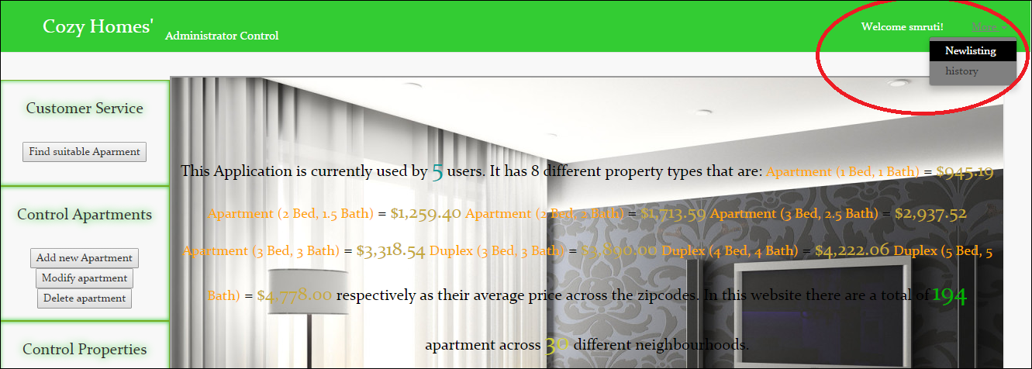
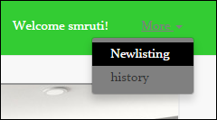
Admins can check the different updates they have done to the properties in the history option.
Admins can use the new listing option to update status of the existing apartments.(Sold, Active).

Slide 40
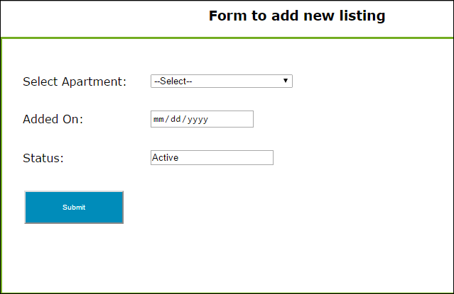
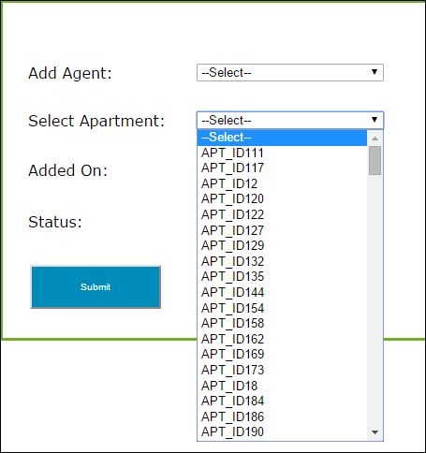
Admins can update information like status of the apartment, if its sold or active.
Populating data from database

Slide 41
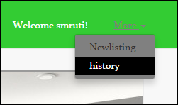
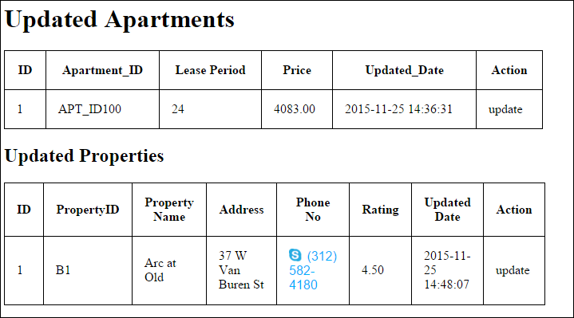
The history option can help admins see the different changes they have done to their property.

Slide 42
Implementing History with Trigger
For Property History : DELIMITER $$ CREATE TRIGGER Admin_Update_property BEFORE UPDATE ON property FOR EACH ROW BEGIN INSERT INTO admin_update_history_property SET action= 'update', apt_id=OLD.ApartmentID, lease= OLD.LeasePeriod, price=OLD.Price, updated_date= NOW(); END$$ DELIMITER ;

Slide 43
Implementing History with Trigger
For Apartment History: DELIMITER $$ CREATE TRIGGER Admin_Update BEFORE UPDATE ON apartment FOR EACH ROW BEGIN INSERT INTO admin_update_history SET action= 'update', apt_id=OLD.ApartmentID, lease= OLD.LeasePeriod, price=OLD.Price, updated_date= NOW(); END$$ DELIMITER ;

Slide 44
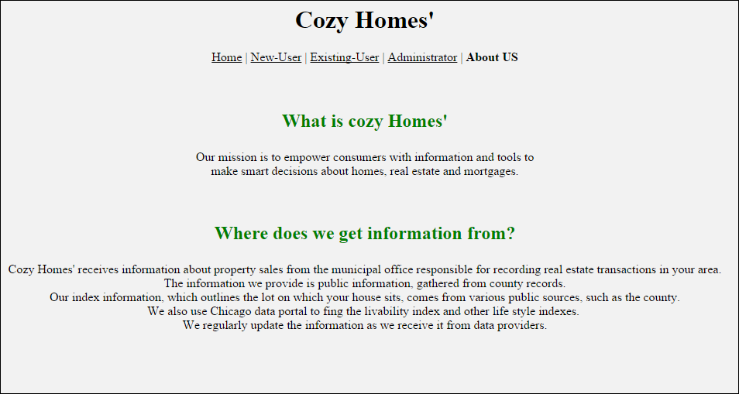
About Us

Slide 45
Thank You
Team 5

